Slide 1
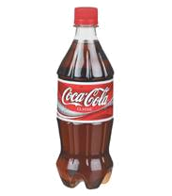
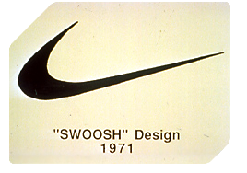
What is a Trademark?
®
Trademark:
A distinctive sign which identifies the goods and services of one company from those of another
A trademark helps consumers to identify and choose between products/services based on their reputation and quality
Coca-Cola registered since 1887
Nike registered since 1971
Notes:
A TM is a link between company and consumers. It may well be the company’s main business asset
Leading branding consultants claim: The product is nothing – the brand is everything
Consumers choose lifestyle and name before quality
Ex1: Coca Cola – both the name and the shape of the bottle are trademarks
Ex2: Nike’s Swoosh – earlier NIKE together with the ”Swoosh”, now identification by the ”Swoosh” alone (trademarks develop over time)
A TM gives you an exclusive right to use the mark for your goods or services
& the right to deny others the use of your mark or a mark similar to yours
lasts 10 years, but can be renewed as many times as you want
Besides: being distinctive and not similar to other marks, it must be graphically reproductive

Slide 2
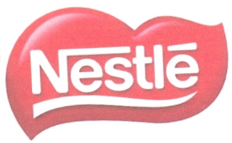
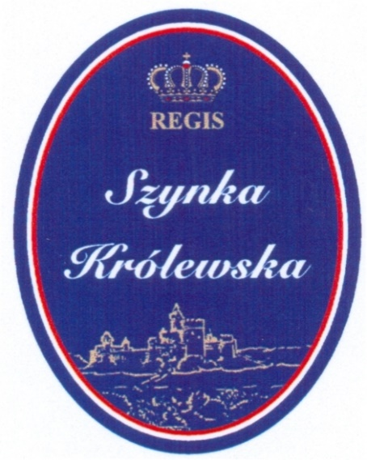
Trademark
Different types of trademarks:
Word e.g. DELICJUSZ
Logo e.g.
Word/Logo e.g.
Notes:
Traditional types of trademarks: Word and figurative signs
Polish examples:
National rights cover Poland
Same legal principles, but practice may be different (different evaluation of trademarks in different countries). Ex. The crown may well be a problem in DK, because we have a monarchy

Slide 3
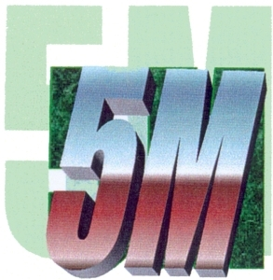
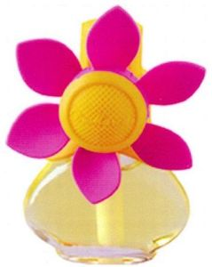
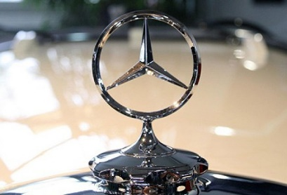
Trademark
Different types of trademarks
Numerals/Letters
3D
Slogans «IMPOSSIBLE IS NOTHING»
Notes:
Numerals: 4711 / letters: Ex: B & O
3D – protection of the shape and packaging of goods (ex. perfume bottles)
Harder to obtain than design registration (because it must have distinctive character
On the other hand: TM is not limited in time (design 5 x 5 years), as TM can be renewed over and over again (ex. The Coca Cola bottle still protected after more than 100 years)

Slide 4
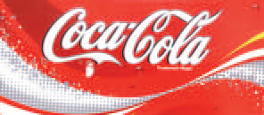


Trademark
Different types of trademark
Well-known mark
Collective mark?
Certification mark?
Notes:
Main rule: TM only protects the same kind of goods or services. EX Fox for cars or soap – no conflict
Well-known brands enjoy a broader protection than ordinary TM’s. Coca-Cola has very broad protection. Kodak-marks
Collective marks (kollektivmærker): A group of owners e.g. a society (Ex is forwashing powder)
Certification marks (garantimærker): can be used by anyone who shows documentation that his product meets given conditions/standards
This Ex is the forerunner of the CE mark
Ex2: Lurpak

Slide 5
Requirements for a Good Trademark
Distinctive (unique)
Not descriptive
Not similar or identical
Notes:
Marks must have distinctive character – they must not be descriptive
Ex1: APPLE – cannot be registered for apples, since it means “apples” but is OK for computers
Ex2: KIDZ– cannot be registered for clothing (could be clothing for children), but OK for fx coffee or tea
Ex3: LUXURY – may describe the quality of the goods
Ex4: DENMARK – (geographical origin) may indicate that the goods are from Denmark
Not similar or identical: likelihood of confusion between two marks, if: Marks are identical or similar & goods or services are identical or similar
Other rules:
Must not be contrary to law, public order or morality. In DK we would never take “Nigger,” or any other racist term.
But DK practice not very strict concerning religion
TM must not be misleading

Slide 6
Distinctive
Distinctive (unique) and not descriptive for the type of product or service being registered
but
if descriptive, it can be registered only if sufficient evidence of use is presented - acquired distinctiveness
Notes:
Principal rule: must be distinctive / must not be descriptive
This is in particular something you have to think about with word marks
Figurative marks: the figurative element fullfills the requirement of distinctiveness, but there is no exclusive right to the words
A word can change character when used for a long time

Slide 7
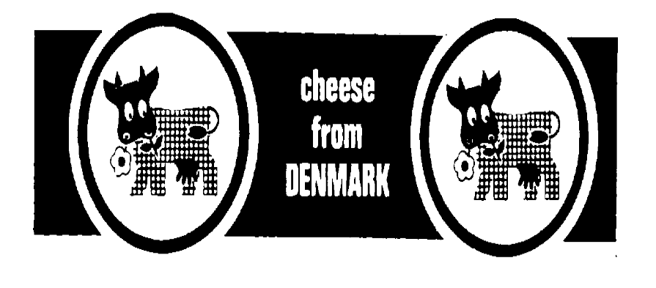
DISTINCTIVENESS
CHEESE FROM DENMARK
TENNISSHOES
ADIDAS TENNISSHOES
Notes:
Left TM cannot be registered
Right is OK
The word mark is descriptive – figurative elements give the mark distinctive character (but no exclusive right to the words – others are free to use them)
Tennisshoes not OK for shoes – the word ADIDAS gives the mark distinctive character (but no exclusive right to the word tennisshoes)

Slide 8


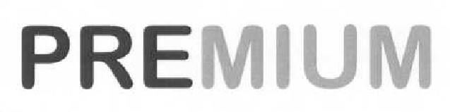
Distinctive Yes No
Word SUPPER
Logo
Word/Logo
Super
Notes:
Polish examples:
Left is OK
Right is not
SUPPER OK (but not for food) - SUPER may indicate the quality, and is an appraisal of the product
Combination of coulours are OK – One black line is not
Words are descriptive, but TM has distinctive character because of the grid – PREMIUM is descriptive, and the use of two different colours is not enough to make it sufficiently figurative

Slide 9
New Kinds of Trademarks
3-dimensional
Sound
Smell
Feel
Moving
What the future brings
Colours
Important: Graphic reproduction!
Notes:
Traditional: Words, logos, numerals/letters
3D: Quite a few examples in DK, Could also be design registrations, but TM is better since it is not limited in time
Sound: a few in DK (Ex1: Lion roar from Metro-Goldwyn-Mayer movies. Ex2: Sound of a Harley Davidson that starts)
Smell: No registrations in DK (yet). Have had one application (Ex: lotion)
Feel: No registrations in DK. Could be the rim of a spectacle lens for glasses from Zeiss
Moving: Few in DK
Colours: No registrations in DK (yet). Have had applications. Ex1: Light purple for MILKA chocolate and deep blue for Cadbury chocolate both in EU. Ex2: Orange for FISKARS scissors in Finland
Graphic reproduction: How is it possible to reproduce ex a smell graphically? A perfume will smell differently on different persons & it will change as you wear it

Slide 10
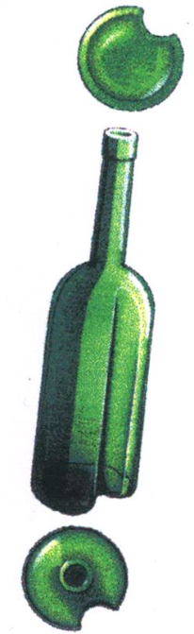
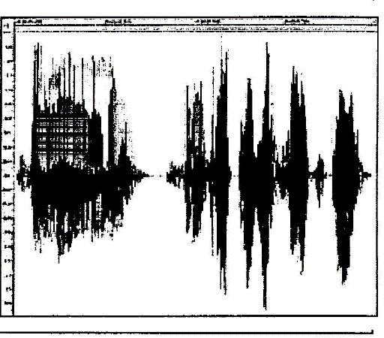
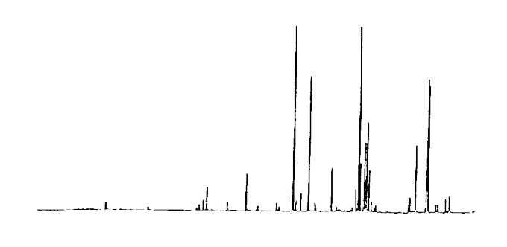
EXAMPLES
3-D
SOUND
”The smell of freshly cut grass”
SMELLS
Notes:
Bottle OK. 3D, and carving in bottle is sufficiently different from other bottles
Sound (Trolden Hugo: “ Hvor skal vi hen du”) is OK. DK accepts oscillograph + the text in writing, since a professional technician can reproduce the sound
Smell Tresor fra Lancome. Not clear, graphical reproduction (different graph at different temperatures)
The written words: “The smell of freshly cut grass” – accepted at OHIM as a smell, but this is not in accordance with DK practice
USA has registered “The smell of roses” for car-tyres

Slide 11
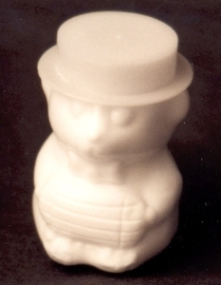
Distinctiveness
3D
Slogan COCA-COLA IS THE MUSIC
÷ THE BEST PIZZAS
UNDER ONE ROOF
+ PEPSI THE CHOICE OF A
NEW GENERATION
Notes:
More examples
Clown of soap is registered – could also have been registred as a design
Slogans:
Ex1: the slogan is not descriptive and Coca Cola is a TM that gives the whole slogan distinctive character => OK
Ex2: descriptive (describe the qualitiy and the goods)
Ex3: Pepsi gives the mark the distinctive character => OK

Slide 12
Exercise
X
Half price for clothes
Jaguar for cars
Tetley for tea bags
Handy for chainsaws
✓
✓
X
Notes:
Distinctive character (explain why)
Ex1: NO (describes the value of the goods)
Ex2: YES (the jaguar is a fast animal, but has nothing to do with a car, only suggests a similarity)
Ex3: YES
Ex4: NO (describes the quality)

Slide 13
Similar/Identical
If it concerns the same or similar/identical products and services:
The name of product/service cannot be similar or identical to a previous mark
however
The same similar/identical brand name can be used for different products/services in different classes
but
Well-known marks have a broader scope
Notes:
Main rule: risk of confusion if 1) and 2)
Similar / identical brand name can be used for different products / services:
- Ex FOX: both for cars and for soap. Identical marks, 2 different goods, can co-exist as no likelihood of confusion. Fox could also be used for computers, but not for motorbikes or spare parts for cars (unless same producer)
Well-known:
Ex PUMA (sports clothing) => wider protection (other shoes & clothing, maybe even bags, sport equipment?)
A few marks are so known/ famous that they can stop new marks – no matter what goods & services (Ex1 Coca-cola. Ex2 Rolls Royce)

Slide 14
Similar/Identical
Meaning the way the mark is:
Written
Looks
Phonetic (sounding)
Conceptual similarity
Notes:
Written
Looks (figurative marks)
Phonetic (the way it sounds)
Conceptual similarity
Ex. DK Board of Appeal: ROCKET =/= POCKET (written similar, sounds similar, BUT 2 different meanings)
Judgement will always be of TM’s as a whole – general impression

Slide 15

Similar/Identical - Examples
Cool/Kool
Written
Looks
Sounding
Conceptual Star/Stern
Basket / Buskit
For You/ 4 U
Notes:
EX 2: The two TM’s give the same overall impression, even though different when analysed

Slide 16
Varied Protection of a trademark
How close can you get to another trademark?
Strong trademark gives wider protection
Weak trademark gives less protection
Notes:
Strong trademarks and well-known marks => wider protection (can prohibit marks that have “some” similarity). Ex1: Coca-cola. Ex2: HARIBO. Ex3: LEGO
Weak trademarks (ex. the word STAR or BRAVO or commonly used symbols e.g. stars or simple geometrical figures are not strong distinctive marks => other marks can be similar “to a certain point” before there is a risk of confusion
Important:
Make a strong and original trademark

Slide 17
Classification system
Like a library system
45 classes
Important to make a good list of goods and services
Think 5 years ahead
Notes:
1-34: goods, 35-45 services. In principle all existing goods and services. More examples class 16: books, paper, etc./ class 25: clothing, footwear, headwear/ class 24: bed linen etc./ class 9: computer software /class 42: computer programming
Important to make correct list of goods and services: Protection covers ONLY what the mark has been registered for (Ex: producer of telephones has mark registered for telecommunication => not very good protection).
Think strategicly:
The first 5 years there is no requirement of use
Therefore - Example: TM you want to use for T-shirts, may as well register for ex shoes or maybe accessories in 18 =>
Strategic advantage for 5 years

Slide 18
International Protection
Trademark filed:
National Office – acquires national protection
EU system:
  EUIPO – acquire protection in 25 member states
International system:
  Madrid Protocol – member states
Notes:
Priority: If you want to expand your TM registration to cover other countries, it is possible to get priority from your first filing up to 6 months
National applications = national protection in different countries. Problem: different languages, and expensive
EU:
One application covers all of EU. System can be used by countries outside of European Union
BUT: If it does not meet requirements in ONE country, it is refused for the whole area
International system:
Must have a Polish (or another national) basis application or registration
Then it’s like a menu card: you pick what you want (one or more countries)
Strategic considerations:
If only Poland and neighboring countries are needed, then maybe EU or intl. mark is not necessary

Slide 19
Consequences of infriging
If you infringe someone else’s trademark or design, you may risk:
Injunction, which means that all the infringer’s products with the infringing trademark on or the same design can be removed from the marked
Destruction of products
Being given a fine
Being sentenced to imprisonment (in gross cases)
Notes:
The damages can be calculated to the amount of loss of for example royalty for the period the infringement has been going on.
I nogle tilfælde, hvor der er tale om kendte mærker, og hvor sagsøgte har udvist en særlig høj grad af uagtsomhed, kan erstatningen godt snige sig pænt over 20.000 euro - eksempelvis afgørelse om Burberry-mærket, hvor erstatningen blev udmålt skønsmæssigt (efter en vurdering af hvad sagsøger måtte forvente at have kunnet få i licensafgift) kr. 150.000 i erstatning. Se hele afgørelsen

Slide 20
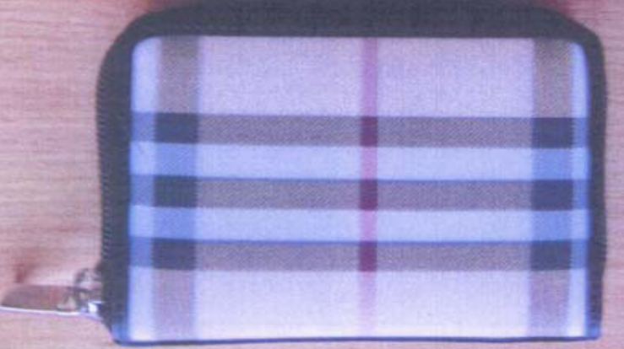
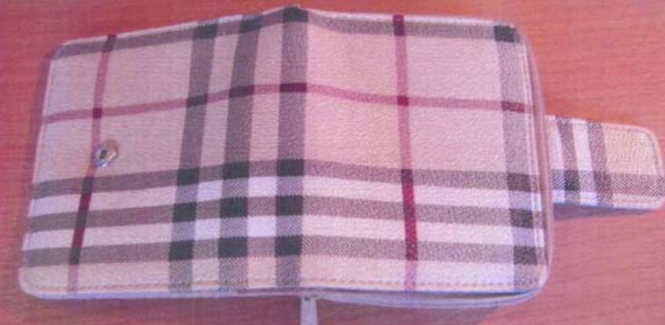
Consequences of infriging
Paying damages to the trademark or design owner
e.g. Burberry vs. Zebra
Notes:
I nogle tilfælde, hvor der er tale om kendte mærker, og hvor sagsøgte har udvist en særlig høj grad af uagtsomhed, kan erstatningen godt snige sig pænt over 20.000 euro - eksempelvis afgørelse om Burberry-mærket, hvor erstatningen blev udmålt skønsmæssigt (efter en vurdering af hvad sagsøger måtte forvente at have kunnet få i licensafgift) kr. 150.000 i erstatning. Se hele domsafgørelsen hos Marianne.

Slide 21
Why register?
®
To have an exclusive right
Stop others from copying
Certificate of ownership
™
Notes:
Exclusive right – stop others from copying
Explanation of ® and TM
Consider your market
Consider advantages and disadvantages of the different systems

